Slide 1
MIS 3301 Intro. to Business Programming Logic
Input, Processing, and Output
Part 3 – print() function options, String Operations, format() function, nesting functions
Mrs. Nancy G. Sánchez

Slide 2
Outline
print() Function - new options
Escape characters
print() - sep & end arguments
String Operations
String Repetition
String Concatenation
format() Function
Formatting Strings
Formatting Floats
Formatting Integers
Alignment of output
Add Dollar Signs

Slide 3
print() – new options
Escape characters
print() - sep & end arguments

Slide 4
Escape Characters
Escape Characters are special characters appearing in string literals. They are treated as commands and are preceded by a backslash (\)
Horizontal tab → \t
Newline → \n
print('John\tDoe\t123456789')
John Doe 123456789
print('John Doe\n123456789')
John Doe
123456789
print('John\tDoe\n123456789')
John Doe
123456789
output_line = 'John\tDoe\n123456789'
print(output_line)
Can also use escape characters in a variable!

Slide 5
Print Blank Line(s)
Use the newline escape character - \n
print() – one blank line
print('\n') – 2 blank lines
print('\n\n') – 3 blank lines

Slide 6
print Function – sep & end arguments
print(object(s), sep=separator, end=end)
Separator
(i.e. delimiter)
End of line
character
print('One', 'Two', 'Three', sep='*', end='!!!')

Slide 7
print Function – sep argument
print('One', 'Two', 'Three')
One Two Three
Default: sep=' '
sep is a print() argument used to override the delimiter.
The delimiter is place between arguments not at the end!
print('One', 'Two', 'Three', sep='-')
One-Two-Three
print('One', 'Two', 'Three', sep='**')
One**Two**Three
print('One', 'Two', 'Three', sep='')
OneTwoThree
print('One', 'Two', 'Three', sep='\t')
One Two Three

Slide 8
print Function – end argument
print('One', 'Two')
print('Three')
One Two
Three
Default: end='\n'
end is a print() argument used to override the end of line character.
print('One', 'Two', end='**')
print('Three')
One Two**Three
print('One', 'Two', end='')
print('Three')
One TwoThree
print('One', 'Two', end=' ')
print('Three')
One Two Three

Slide 9
print Function – sep & end arguments
Can use both sep & end arguments!
print('A', 'B', 'C', sep='**', end='&')
print('D', end='!!!')
What will this display?
?
print('One', 'Two', '\nThree', 'Four', sep='\t')
What will this display?
?
first_name = 'John'
last_name = 'Doe'
print(first_name, last_name, ', MD')
Copy the code to the Text Editor Window
& fix Line 3 so that it displays like this…
John Doe, MD
Note: Use the concepts on this slide!

Slide 10
You try it!
Copy this code. In the Editor Window, edit the code to produce the output below.
You must achieve this by only adding sep & end arguments.
print('A','B','C')
print('D','E')
print('F','G')
Output
Paste your solution here…
A-B-C
DE$$F#G

Slide 11
String Operations
String repetition
String concatenation

Slide 12
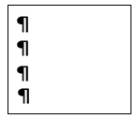
String Repetition
Use an asterisk (*) to repeat a string multiple times.
Can use in print()
print('ab' * 2)
print('123' * 3)
print(' ' * 5)
print('\n' * 3)
Can store in a variable
warning = '!' * 5
banner_line = '*' * 10
abab
Memory
123123123
warning
'!!!!!'
→ 5 non-printable
blank characters
Memory
banner_line
'**********'
4 blank
lines
Why would you put it in a variable?

Slide 13
String Concatenation
Sometimes we need a variable to hold a concatenated value.
The + operator between 2 strings performs string concatenation.
i.e. it joins 2 strings together – warning: both operands must be a string!
full_name = first_name + last_name
JohnDoe
stud_info = first_name + ' ' + last_name + '\t(123456789)'
John Doe (123456789)
full_name = first_name + ' ' + last_name + ', ' + 'MD'
John Doe, MD
Don’t forget that with the print() function, there are arguments & these must be separated by commas!
print(first_name, ' ', last_name, ', MD', sep='')
John Doe, MD

Slide 14
You try it!
In the Editor Window, write the code to produce the output below.
Use String Repetition!
Output
Paste your solution here…
********************
Hello World!
********************

Slide 15
String Concatenation – Warning!
Warning: both operands must be a string!
To produce this using a literal for the number…
Doe 20
output = last_name + ' ' + 20
TypeError: can only concatenate str (not "int") to str
Soln >>
output = last_name + ' 20'
To produce this using a variable for the number…
Doe, John - 123456789
student_ID = 123456789
student_info = full_name + ' - ' + student_ID
TypeError: can only concatenate str (not "int") to str
Soln >>
student_info = full_name + ' - ' + str(student_ID)

Slide 16


format() function
Formatting Strings
Formatting Floats
Formatting Integers
Alignment of output

Slide 17
format() Function
format(any_value, 'format_specifier')
This argument
must be a string
Format Specifier syntax - do not add spaces!
[alignment][width][,][.precision][type]
< left
> right
^ center
field width
(minimum)
enable
comma
# decimal
Values
(rounds)
f – fixed-point notation
d – decimal integer
s – string
% – percentage

Slide 18
format() Function - strings
Formatting Strings
function
value
format_spec
Format Specification options:
< – alignment: < left, > right, ^ center default for strings is left, may omit
7 – width: minimum # of spaces reserved to hold this string
s – type: (s): string, may omit with strings
format('abc', '<7s')
return value is a string
'abc····'

Slide 19
format() Function - strings
format('abc', '7')
'abc····'
For strings, Left Align
is the default. Thus, the symbol may be omitted
or… format('abc', '<7s')
format('abc', '>7')
'····abc'
Right align
format('abc', '^7')
'··abc··'
Center align
format(full_name, '^25')
'········John Doe·········'
Can also format variables
To see the value, you must print it!
print(format(full_name, '^25'))

Slide 20
format() Function - floats
Formatting Numbers
Format Specification options:
> – alignment: < left, > right, ^ center default for numbers: is right, may omit
12 – width: minimum # of spaces to hold this string
, – comma style: enabled
.2 – precision: # of decimal places
f – type: for numbers, use (f): float; (d): int
function
value
format_spec
format(12345.6789, '>12,.2f')
return value is a string
'···12,345.68'
Total: 12 characters

Slide 21
format() Function - floats
For numbers, Right Align
is the default
format(1234.567, '12,.2f')
'····1,234.57'
format(1234, '10f')
or… format(1234.567, '>12,.2f')
Width = 12, commas,
2 decimals, default: > Right align
'1234.000000'
If missing precision, 6 decimals are appended
format(1234.567, '<12,.2f')
'1,234.57····'
< Left align
format(1234.567, '3.2f')
'1234.57'
format(1234.567, '^14.1f')
'····1234.6····'
Width = 3 is ignored because it is not wide enough
^ Center align – no comma style

Slide 22
format() Function - integers
Formatting Numbers
Format Specification options:
> – alignment: < left, > right, ^ center default for numbers: is right, may omit
12 – width: minimum # of spaces to hold this string
, – comma style: enabled
d – type: for numbers, use (f): float; (d): int
function
value
format_spec
format(12345, '>12,d')
return value is a string
'······12,345'
Total: 12 characters

Slide 23
format() Function - integers
For numbers, Right Align
is the default
format(1234, '7d')
'···1234'
format(1234.567, 'd')
or… format(1234, '>7d')
Width = 7,
> Right align
ValueError: Unknown format code 'd' for object of type 'float'
format(1234, '<7,d')
'1,234··'
< Left align
format(1234, '3d')
'1234'
Width = 3 is ignored because it is not wide enough
format(1234, '^9,d')
'··1,234··'
^ Center align

Slide 24

format() Function nested with print()
print('The number is', format(12345.6789, '12,.2f'))
The·number·is····12,345.68
String literal
Total: 12 characters

Slide 25
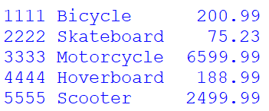
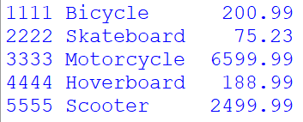
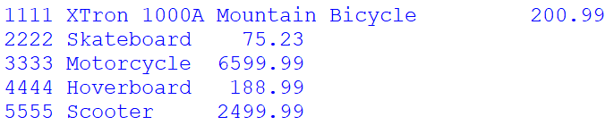
Alignment of Output
print(1111, 'Bicycle\t', format(200.99, '7.2f'))
print(2222, 'Skateboard\t', format(75.23, '7.2f'))
print(3333, 'Motorcycle\t', format(6599.99, '7.2f'))
print(4444, 'Hoverboard\t', format(188.99, '7.2f'))
print(5555, 'Scooter\t', format(2499.99, '7.2f'))
print(1111, 'XTron 1000A Mountain Bicycle\t', format(200.99, '7.2f'))
print(2222, 'Skateboard\t', format(75.23, '7.2f'))
print(3333, 'Motorcycle\t', format(6599.99, '7.2f'))
print(4444, 'Hoverboard\t', format(188.99, '7.2f'))
print(5555, 'Scooter\t', format(2499.99, '7.2f'))
Is tabbing a good solution for alignment of output? YES or NO

Slide 26

Alignment of Output
Better Solution for alignment of output!
Don’t tab, use format() for every column!
20 characters
10 characters
car1 = 'Toyota Highlander'
price1 = 34600.12
car2 = 'Honda Pilot'
price2 = 34530.77
car3 = 'Chevrolet Tahoe'
price3 = 49000.98
print(format(car1, '20'), format(price1, '10,.2f'), sep='')
print(format(car2, '20'), format(price2, '10,.2f'), sep='')
print(format(car3, '20'), format(price3, '10,.2f'), sep='')
Formatting the car variable (a string)
Formatting the price (a float)
No spaces

Slide 27
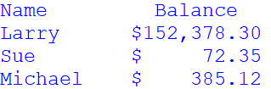
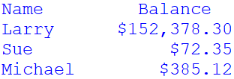
Aligning Dollar Values
Accounting Format
Currency Format
print(format('Name','10s'), format('Balance','^10s'))
name = 'Larry'
num = 152378.3
currency_num = '$' + format(num, ',.2f')
print(format(name,'10s'), format(currency_num,'>11'), sep='')
name = 'Sue'
num = 72.3498
currency_num = '$' + format(num, ',.2f')
print(format(name,'10s'), format(currency_num,'>11'), sep='')
name = 'Michael'
num = 385.123
currency_num = '$' + format(num, ',.2f')
print(format(name,'10s'), format(currency_num,'>11'), sep='')
print(format('Name','10s'), format('Balance','^10s'))
name = 'Larry'
num = 152378.3
print(format(name,'10s'), '$', format(num, '10,.2f'), sep='')
name = 'Sue'
num = 72.3498
print(format(name,'10s'), '$', format(num, '10,.2f'), sep='')
name = 'Michael'
num = 385.123
print(format(name,'10s'), '$', format(num, '10,.2f'), sep='')
Field headers
Create a string
Align the string

Slide 28
Exercises

Slide 29
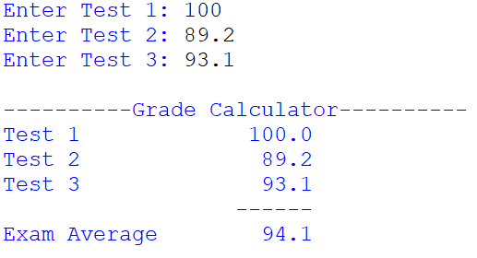
Exercise – Formatting
Write a program that will calculate the average for three tests and display the average of the test scores.
Add 3 comment lines for: Input, Process, Output
Get the first test score.
Get the second test score.
Get the third test score.
Calculate the average by adding the three test scores and dividing the sum by 3.
Display the average.
Right align the outputted averages by using the format() function.
Save your program as: Ch2-Ex04-Formatting.py
Run it!

Slide 30
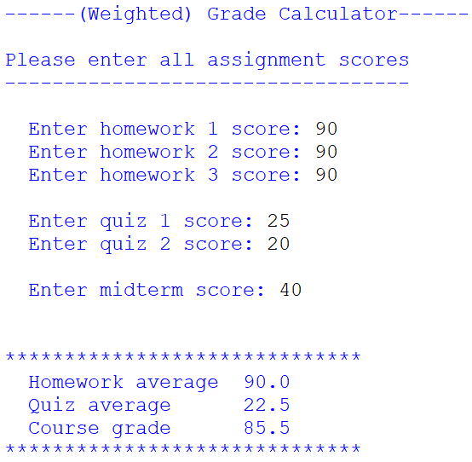
Exercise – Summary
Write a program that will calculate the overall grade (as a weighted average) for a user. There are 3 homework assignments, 2 quizzes and 1 midterm exam.
Ask the user to input their scores for each homework (max score: 100), quiz (max: 25) and midterm (max: 50).
Calculate the 2 averages.
Calculate the course grade which is a weighted score: homework is worth 25% of the overall grade, quizzes are 30%, and the midterm is 45%.
Display the output. Make sure the 3 scores are perfectly aligned to the right.
Go back through your code and make sure to replace any magic number with a constant.
Save your program as: Ch2-Ex05-Summary.py
Run it!

Slide 31
Nesting Functions

Slide 32
Nesting Functions
You can nest functions together – i.e. place a function within a function
pay_rate = float(input('Enter pay rate: '))
print('Pay rate:', format(pay_rate, '4.2f'), type(pay_rate))

